Slide 1
Map Compositions & More..
Introduction by Karel Charvat

Slide 2

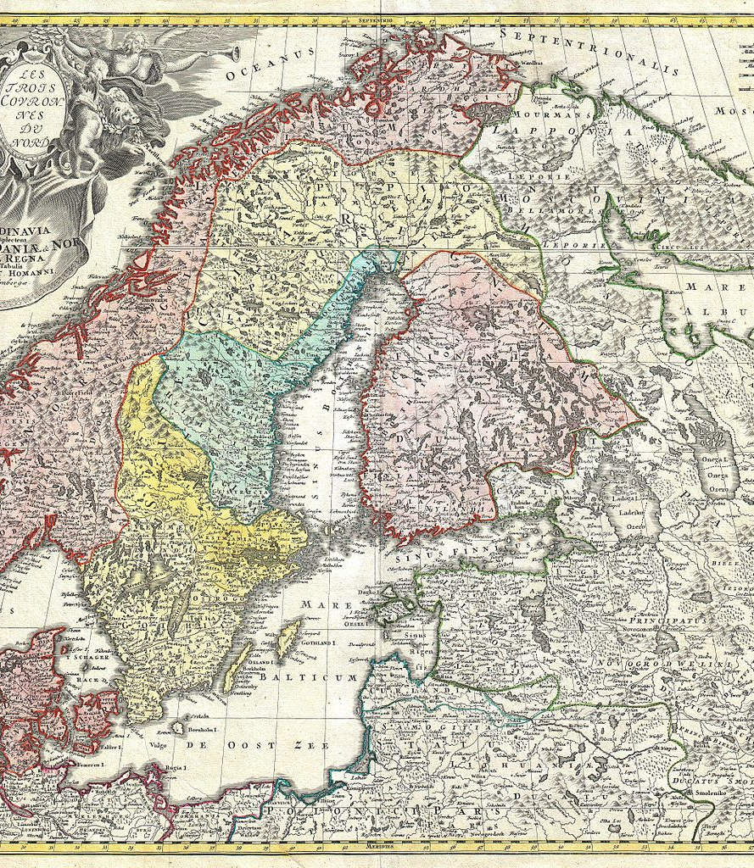
Collaboration and Maps
Notes:
Consider how we use maps on the Internet
We share data files (xls, csv, shape etc.)
We share services (wms, wfs, wcs)
We share applications (yourmap.xyz)
We build data collaboratively between one person and one application
When we share maps we make them into documents

Slide 3
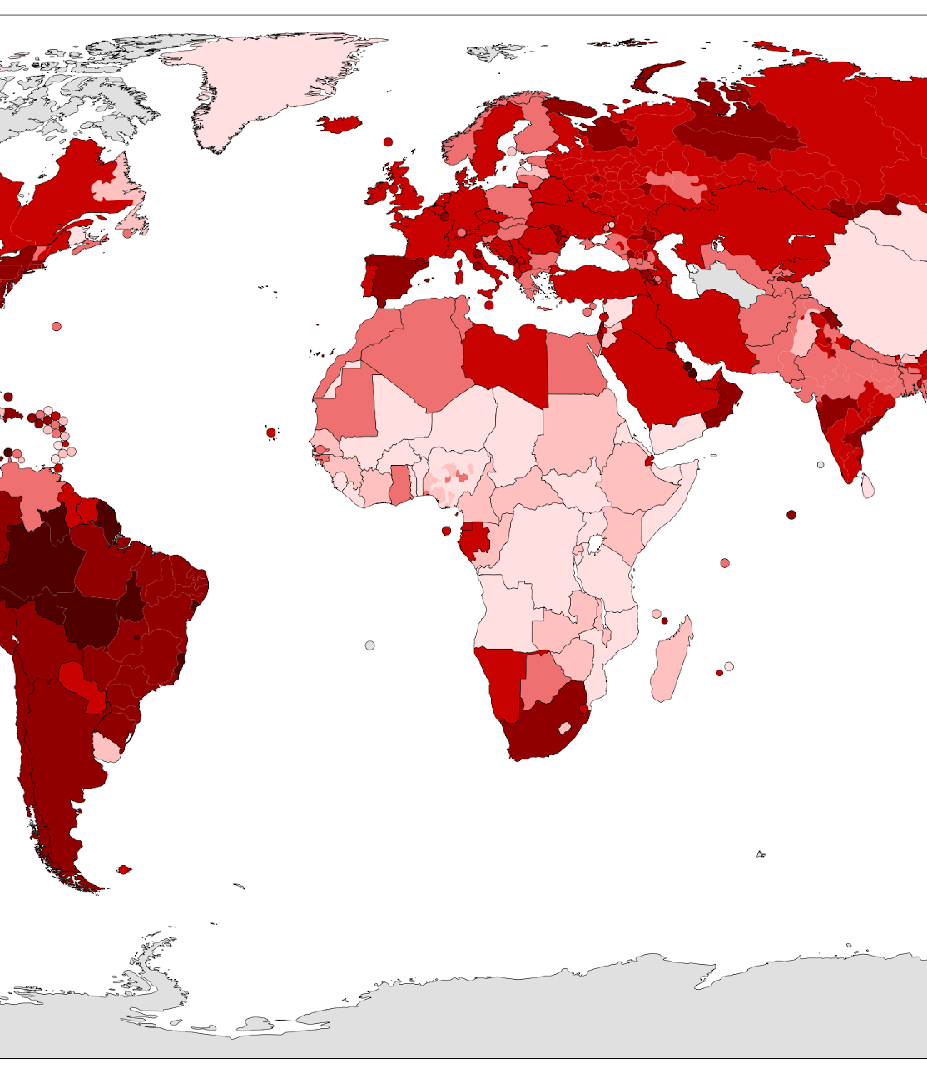
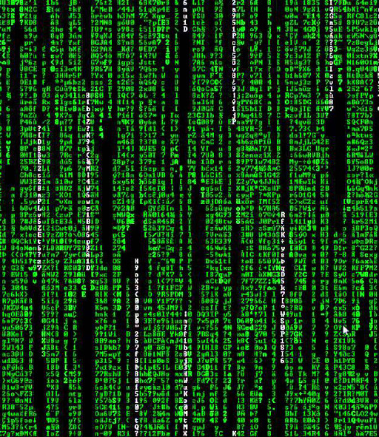
Why all this fuzz about “maps”?
Notes:
The map tells a message that the data does not
Maps are communication
Maps are biased

Slide 4
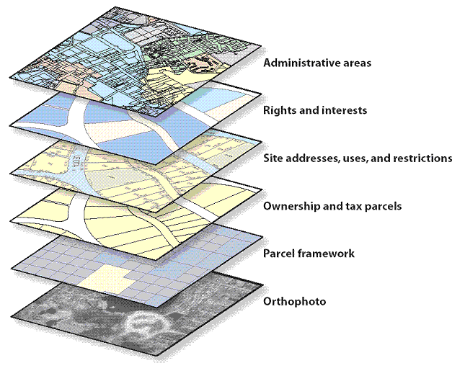
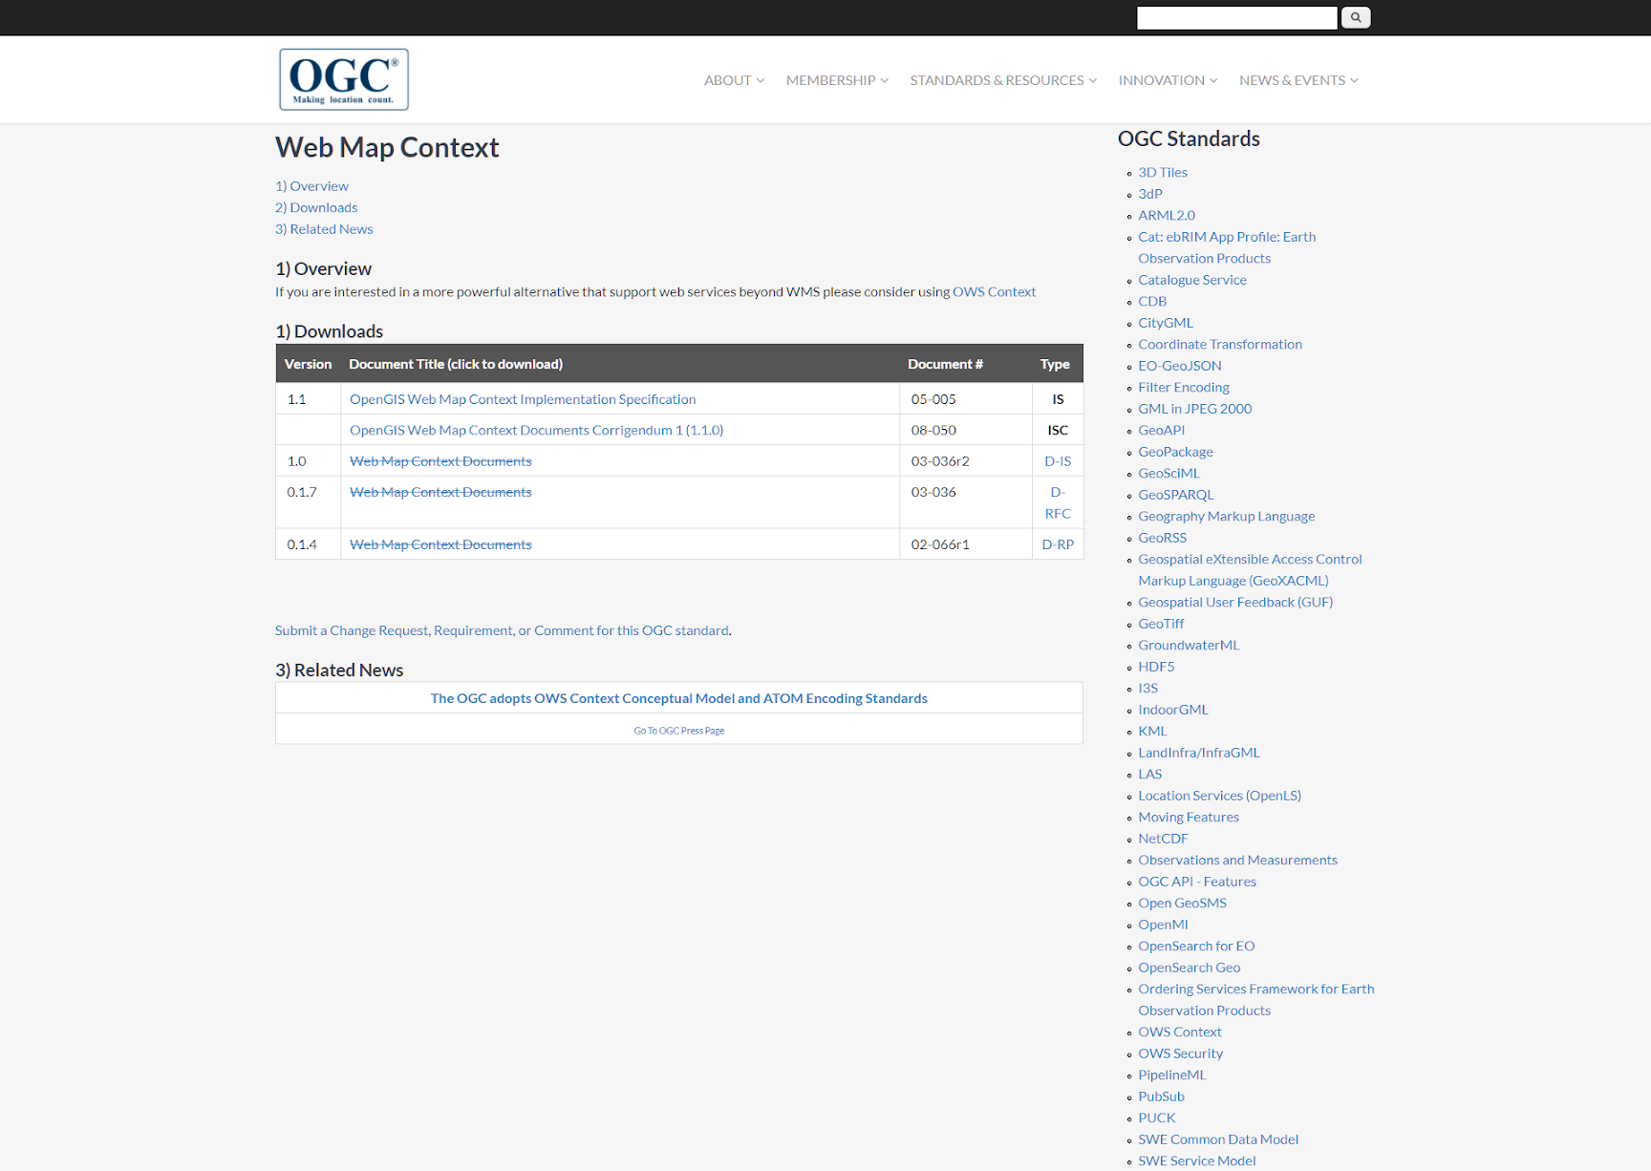
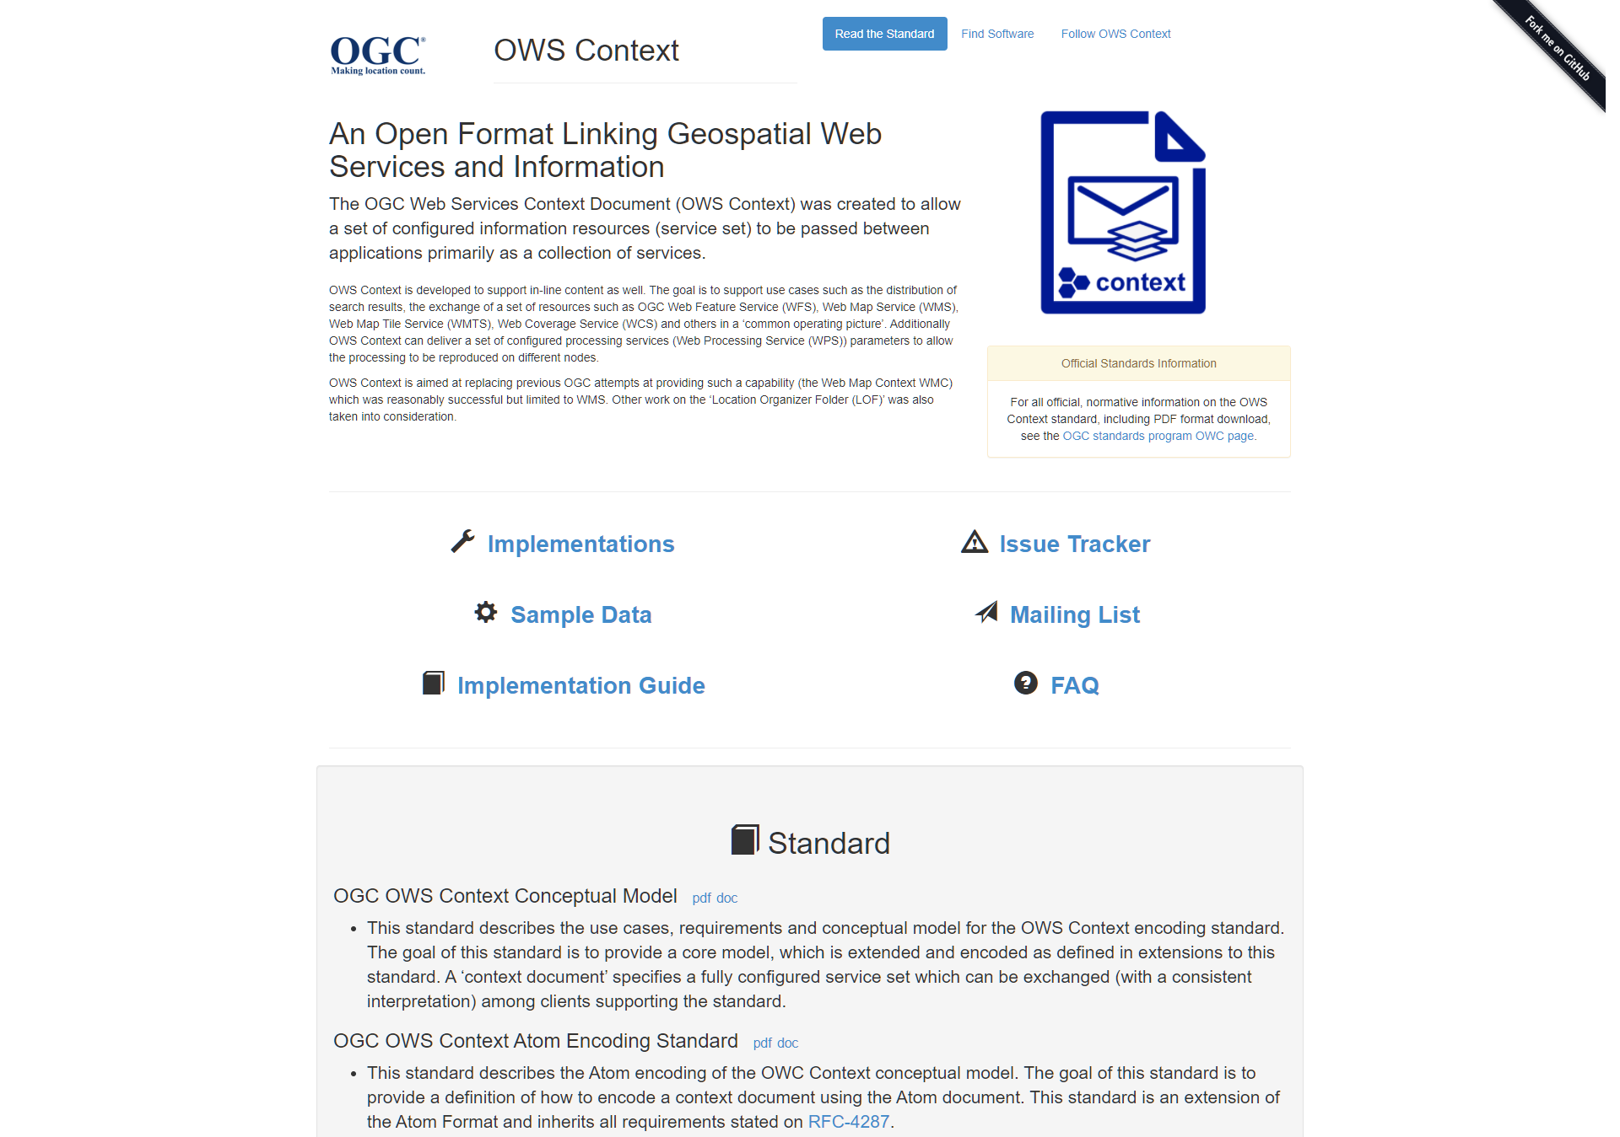


What are Map Compositions?
Notes:
An interchangeable "transport" for sharing maps rather than data or services
Legacy
Web Map Context
OWS Context Service
Possible wink to MapML
ArcGIS Project file
QGIS Project file
Mapserver Map file
Geoserver project file
Innovation
Layman
Providing JSON format for storing maps composed from online services and embedded data

Slide 5
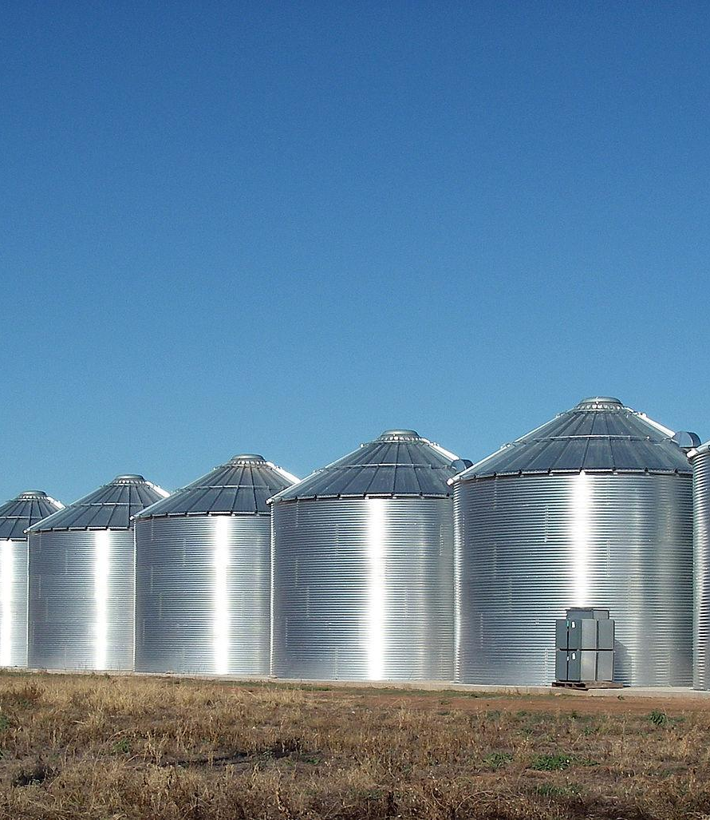

Why Map Compositions?
Notes:
Maps are also data - sharing the totality rather than just the pieces
Why?
Web clients are replacing for offline tools
Mobile apps are replacing desktop apps
Different organizations use different tools (and should probably do so)
Possibility to share data across web tools

Slide 6
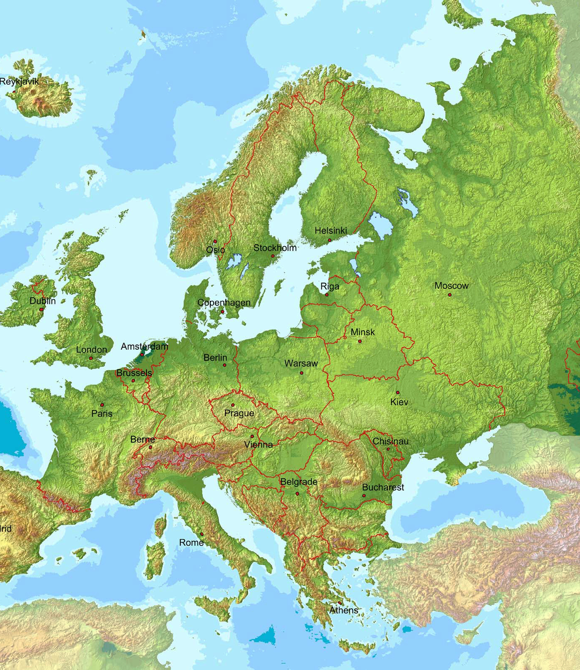

What is a Map Whiteboard?
Notes:
Legacy, Inspiration
"Screen sharing. remote control"
Google Doc
Innovation
Using WebSockets to stream interactions from connected clients
Collaboratively build GeoJSON
Add layers
Save maps (as compositions)

Slide 7



What can Map Whiteboards do?
Notes:
Government collaboration
Replace paper maps
Enhance cross-sector cooperation
Expert-expert interactions
Policy development
Meetings
Expert-non-expert interactions
Guidance
Field data capturing

Slide 8



Attend our breakout session on Collaborative Map Making
Karel Charvat
Raitis Berzins
(Stein) Runar Bergheim

